Slide 1
Spanning tree Portfast

Slide 2
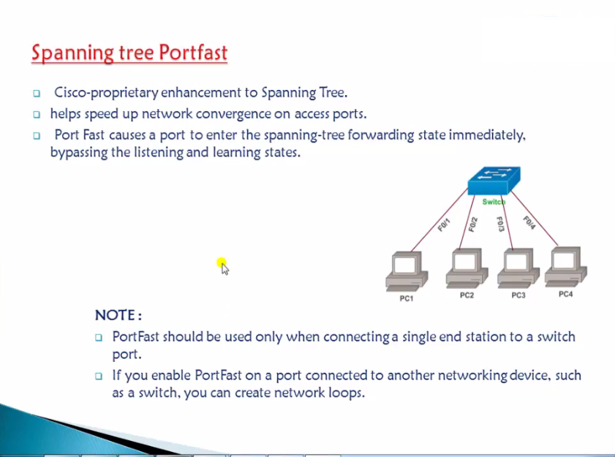

Slide 3
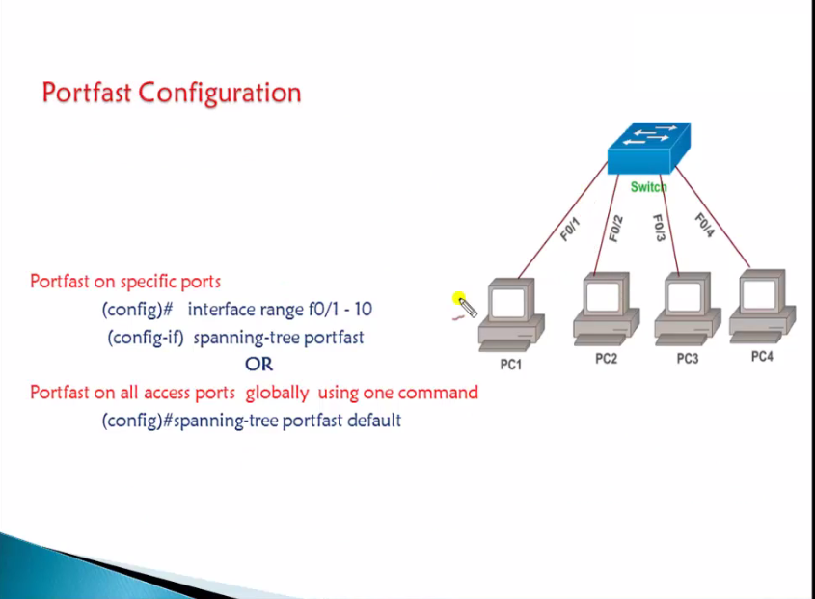

Slide 4
Thank you…

